Slide 1

US • EU • UK • CN
Global AI Regulation Briefing
(2016–2025)
What leaders need to know: US, EU AI Act, UK, and China—risk frameworks, obligations by role, controls, enforcement, and how to operationalize compliance.

Slide 2
Executive Agenda
1
Glossary: Shared language for speed
2
Regulatory Timeline (2016–2025): What happened, what's next
3
Comparison Matrix: US, EU AI Act, UK, China
4
Obligations by Role: Developer vs. Deployer
5
Risk Taxonomy: Mapping use‑case risk
6
Governance Operating Model: Who decides, who signs
7
Data/ML Lifecycle Controls: Build‑to‑operate gates
8
Enforcement Caselets: Patterns and lessons
9
Adoption Roadmap: 0–18 months
10
KPI Dashboard: What to track

Slide 3



Rapid Glossary
AI SYSTEM
GPAI / FOUNDATION MODEL
A machine‑based system that infers or outputs predictions, content, or decisions influencing environments (EU/US‑aligned summary).
General‑purpose model capable of a wide range of tasks (e.g., large language models), sometimes with extra obligations.
CONFORMITY ASSESSMENT
HIGH‑RISK SYSTEM
EU pre‑market checks for high‑risk systems (QMS, technical documentation, testing, CE marking).
EU AI Act category for systems with significant impact on health, safety, or fundamental rights; triggers strict obligations.
ALGORITHM FILING (CN)
PROVIDER / DEVELOPER
China CAC record‑filing and security assessment for recommendation/generative/deep synthesis algorithms.
Entity that develops or places an AI system on the market (EU 'provider'); roughly 'developer' in US/UK usage.
IMPACT ASSESSMENT
DEPLOYER / USER
Risk assessment focusing on safety, bias, privacy, and rights (AIA/'AIIA', DPIA, US agency assessments).
Entity that uses an AI system under its authority (EU 'deployer'); 'operator'/'user' elsewhere.

Slide 4
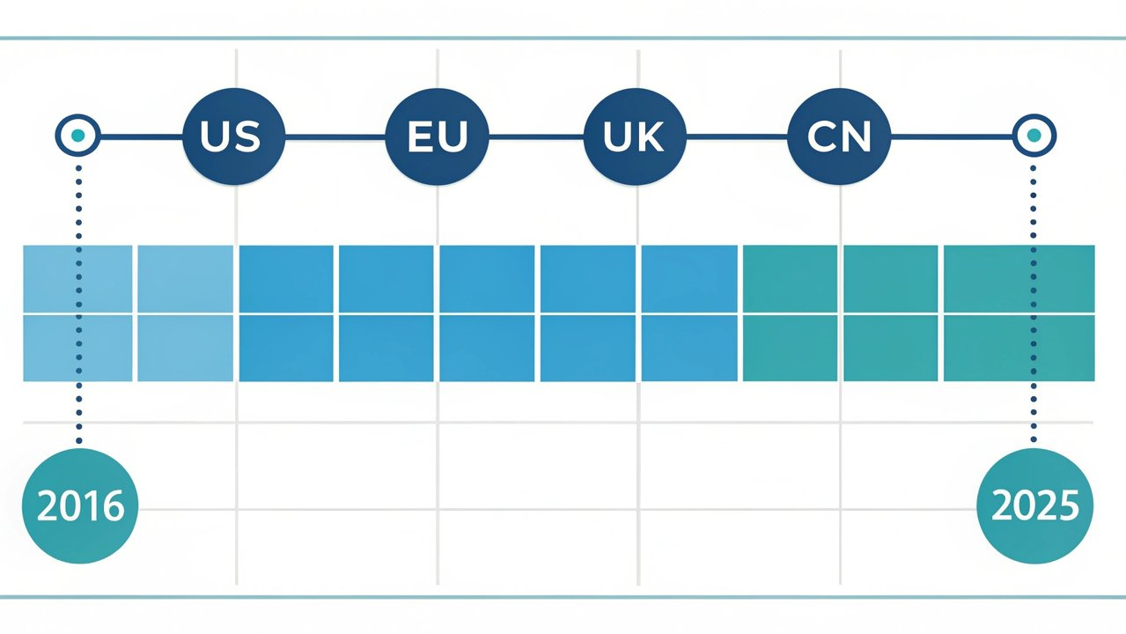
Regulatory Timeline (2016–2025)
2016
EU
GDPR adopted — Privacy and data governance bedrock for AI training and deployment.
2017
CN
Cybersecurity Law effective — Security, data localization foundations.
2019
EU
AI Ethics Guidelines — Trustworthy AI principles.
2021
EU
EU AI Act proposed — Risk‑based framework draft (Apr).
2022
CN
Algorithm Recommendation Provisions — Filing, transparency, fairness (Mar).
2023
US
NIST AI RMF 1.0 — Voluntary risk framework (Jan).
2023
US
Executive Order 14110 — Safety, testing, reporting; agency actions (Oct).
2023
UK
Pro‑Innovation Approach + AI Safety Summit — UK AI Safety Institute launch.
2023
EU
Political agreement on AI Act — Final trilogue deal (Dec).
2024
US
OMB M‑24‑10 — Federal inventories, impact assessments, governance (Mar).
2024
EU
AI Act adopted; phased application — Bans/GPAI first; high‑risk 2025–2026.
2023–2025
CN
Deep Synthesis/GenAI Measures — Labeling, security review, filing for generative services.

Slide 5
Comparison Matrix — US, EU, UK, China
Category
United States
European Union (AI Act)
United Kingdom
China
Scope/Approach
Sectoral + executive/agency actions; risk management guidance (NIST AI RMF)
Horizontal risk‑based regulation across the single market
Principles‑based, regulator‑led (safety, security, fairness, accountability, contestability)
Content/security‑focused measures for algorithms, deep synthesis, and generative AI
Risk Tiers
No singular statutory tiers; agency/context‑based risk
Unacceptable (banned), High‑risk, Limited‑risk, Minimal‑risk; GPAI duties
No statutory tiers; risk‑proportional guidance via regulators
Risk managed via security assessments, content rules, and filings
Prohibited Uses
No national AI‑specific bans; constraints via existing laws (UDAP, civil rights, safety)
Manipulative, social scoring, certain biometric uses (subject to narrow exceptions)
Case‑by‑case under existing laws (data protection, consumer, competition, safety)
Content that endangers national security, social order, or violates public policy/law
Key Obligations (Provider)
Safety testing/red‑teaming and reporting for powerful models per EO; transparency claims scrutiny (FTC)
QMS, data governance, risk mgmt, technical docs, logging, human oversight, CE marking for high‑risk; GPAI model transparency/diligence
Demonstrate adherence to principles; engage with regulators; UK AI Safety Institute evaluations for frontier models
Algorithm filing, security assessments, training data provenance, content moderation, watermarking/labeling
Key Obligations (Deployer)
Agency impact assessments (OMB) for federal uses; sector rules (EEOC, CFPB, FDA, etc.)
High‑risk use‑case risk mgmt, competent human oversight, logs, transparency to users; fundamental‑rights impact assessments in some contexts
Risk assessments, transparency, DPIAs where relevant; sector regulator guidance (ICO, FCA, CMA, MHRA)
Real‑name verification, user notice, complaint handling, moderation workflows
Enforcement
FTC, DOJ, EEOC, CFPB, FDA, NHTSA, state AGs, others
National market surveillance authorities + EU coordination
Existing regulators (ICO, CMA, FCA, MHRA, HSE) with coordination
CAC (primary), with MIIT and other authorities
Penalties
Existing law penalties (UDAP, discrimination, safety)
Significant administrative fines (multi‑million EUR and/or % of global turnover, by infringement)
Under existing regimes (e.g., UK GDPR fines, consumer law remedies)
Administrative fines, rectification orders, suspension of services
Status
Active via EO/agency guidance; legislation evolving
Adopted 2024; phased application 2025–2026
Principles in force; further guidance and evaluations ongoing
In force; filings and rectifications ongoing

Slide 6


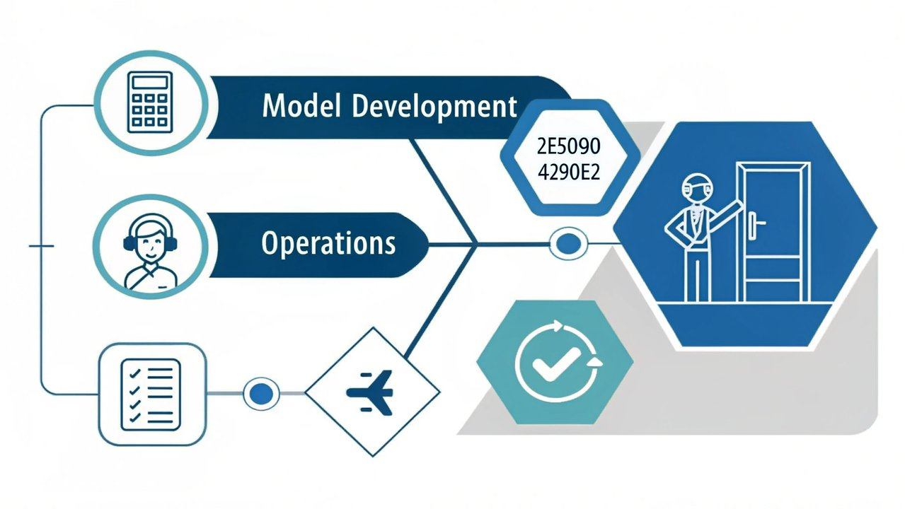
Obligations by Role: Developer vs. Deployer
Developer/Provider
Deployer/User
Establish AI QMS
Use‑case risk assessment
Policies, roles, training, documentation.
Context, impact on individuals/rights, safety dependencies.
Data governance
Provenance, consent/rights, quality, representativeness.
Human oversight design
Competence, escalation/override, fallback procedures.
Model risk management
Operational controls
Testing (safety, security, bias, robustness), adversarial/red-team exercises.
Logging, monitoring, incident reporting, rollback plans.
Technical documentation
Transparency to end‑users
Model cards, data sheets, evaluation reports, usage constraints.
Notices, labeling (e.g., synthetic content), records retention.
High-risk/GPAI specifics
Sectoral compliance
EU conformity approach, GPAI transparency/diligence; US EO reporting for powerful models; CN algorithm filing/security review.
Employment, credit, health, safety; public sector IA (OMB/UK, where applicable).

Slide 7
Risk Taxonomy and Examples
Unacceptable
Examples: Manipulative or social‑scoring systems; Real‑time remote biometric ID in public (narrow exceptions)
Treatment: Prohibited (EU) or highly restricted elsewhere
High‑Risk
Examples: Employment screening; Creditworthiness; Medical devices; Critical infrastructure
Treatment: QMS, testing, documentation, registration/marking, strong oversight
Limited‑Risk
Examples: Chatbots requiring disclosure; AI that interacts with the public
Treatment: Transparency obligations; basic controls
Minimal‑Risk
Examples: Spam filters; AI‑assisted spelling
Treatment: Good‑practice controls; minimal regulation
Regional Crosswalk
EU:
Direct mapping to tiers above
US:
Context‑based; align 'high‑risk' to safety‑, rights‑, or critical‑function contexts (OMB/NIST)
UK:
Principles‑proportionate; treat higher potential harm as 'high‑risk'
CN:
Risk via security/content impact; uses triggering filing/review treated as high‑risk

Slide 8
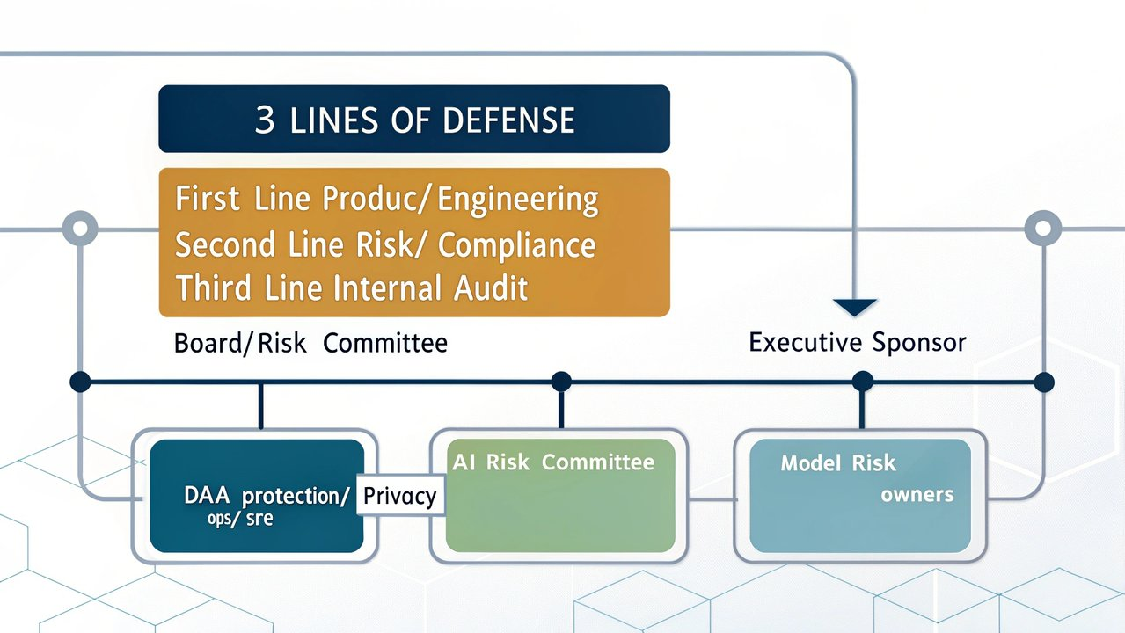



Governance Operating Model
Three Lines of Defense
1st line: Product/Engineering/Operations
2nd line: Risk/Compliance/Privacy
3rd line: Internal Audit
Own controls; Implement policies; Execute day-to-day risk management
Set policy; Review and challenge; Provide expertise and guidance
Independently assure; Validate control effectiveness; Report to board
RACI – Key Decisions
Decision
Responsible
Accountable
Consulted
Informed
Classify use‑case risk
Product
Exec Sponsor
Risk/Privacy
Audit
Approve high‑risk deployment
AI Risk Committee
Board/Risk Cttee
Legal/MRM
Ops
Incident disclosure/notification
Ops/Security
Legal/Privacy
Comms
Execs

Slide 9
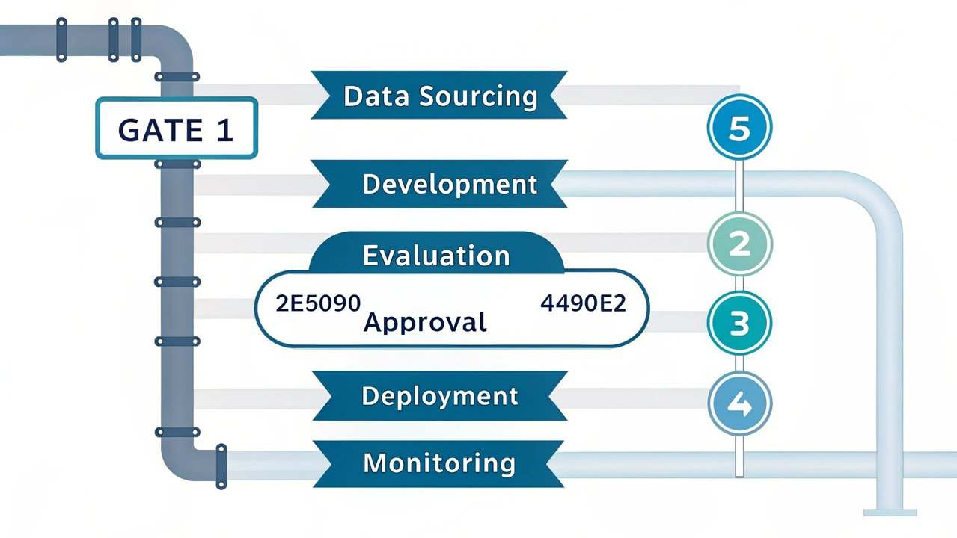
Data/ML Lifecycle Controls
Data Sourcing
Development
Evaluation
Approval
Deployment
Monitoring
Provenance/consent checks
Documented objectives
Accuracy/robustness tests
Impact assessment
Feature flags/kill-switch
Drift detection
Sensitive data minimization
Training/validation splits
Bias/fairness metrics
Human oversight design
User notices/labeling
Incident logging/triage
Secure training pipelines
Red-team exercises
Regulatory sign-offs
Access controls
Periodic re-validation
Data quality SLAs
Gates: Gate 1 (Build complete), Gate 2 (Risk/Privacy review), Gate 3 (Independent validation), Gate 4 (Go-live), Gate 5 (Periodic review)

Slide 10
Enforcement Caselets (Illustrative)
United States
Issue: Retail facial recognition harms (accuracy, false positives, inadequate controls)
2023
Outcome: Order restricting use; mandated safeguards and assessments; highlights UDAP risk for AI deployments.
FTC
EU (Italy)
Issue: LLM transparency, age-gating, and data rights
2023
Outcome: Temporary restrictions lifted after remedial measures; signals strong transparency/data rights expectations.
Garante
US (NYC)
Issue: Automated employment decision tools (bias audit and notices)
2023–2024
Outcome: Enforcement of bias audit and candidate disclosure requirements; employers adjust hiring AI workflows.
DCWP
United Kingdom
Issue: Facial recognition and web-scraped biometrics
2022–2023
Outcome: Orders and fines under data protection; subsequent appeals tested jurisdiction—signals scrutiny of biometric AI.
ICO
China
Issue: Generative/deep synthesis services (labeling, filings)
2023–2024
Outcome: Rectification and filing requirements before/after launch; emphasizes security review and content controls.
CAC
Note: Examples reflect applicable legal regimes (consumer protection, data protection, sector safety) used to police AI before/alongside AI-specific laws.

Slide 11
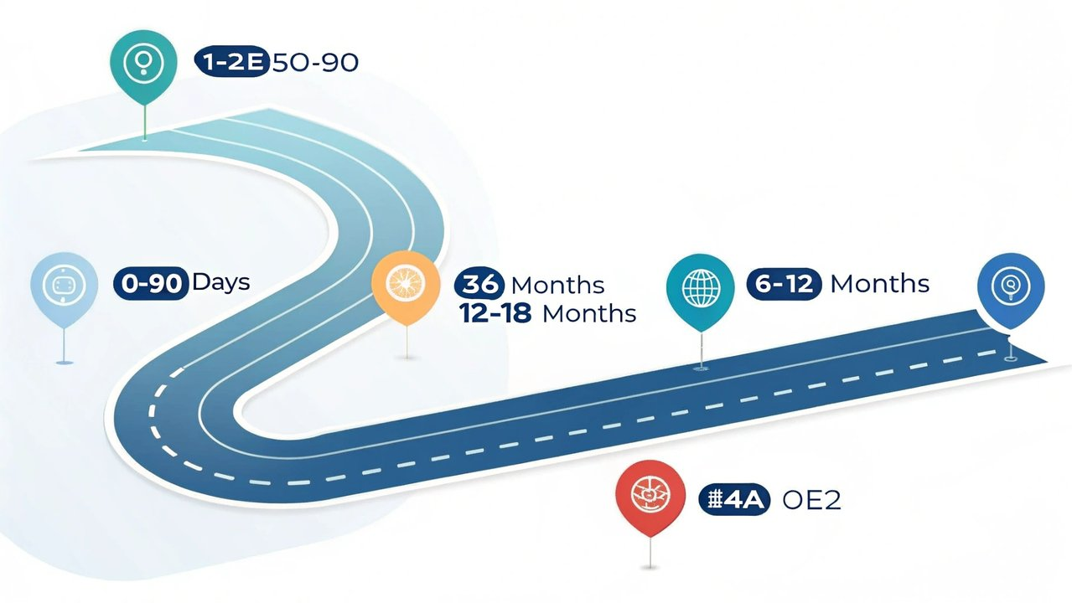
Adoption Roadmap (0–18 Months)
0–90 days
3–6 months
6–12 months
12–18 months
Actions:
Actions:
Actions:
Actions:
Appoint accountable exec; stand up AI Risk Committee
Implement lifecycle gates, AIA/DPIA templates, and model cards
Independent validation (MRM) for high-risk; bias/security testing
EU: complete conformity assessments/marking for high-risk systems
Inventory AI use-cases and models (incl. vendor/GPAI)
Stand up monitoring and incident playbooks; enable kill-switches
US: align with NIST AI RMF; OMB requirements for public sector
Third-party assurance (internal audit; external attestations)
Triage into risk tiers; freeze unclassified high-impact uses
Map EU high-risk candidates; plan CE/technical documentation
CN: prepare/submit filings; implement labeling/watermarking
Optimize KPIs; continuous improvement loop
Deliverables:
Deliverables:
Deliverables:
AI policy baseline
Gate checklist + evidence pack
Validation reports
Deliverables:
Use-case registry
Monitoring runbooks
NIST RMF alignment map
CE marking (where required)
Initial risk classification
EU technical doc outline
CN filing dossier
Assurance reports
Quarterly KPI pack

Slide 12


KPI Dashboard (Executive View)
Filters:
Region: All
US
EU
UK
CN
Risk Tier
Business Unit
Last updated: Nov 10, 2025
% AI Inventory Complete
% High-Risk Approved
Bias/Security Tests Pass Rate
Inventoried AI uses / known uses
Approved high-risk uses / total high-risk identified
Passed required tests / total required
95%
90%
7%
3%
IT
HR
Finance
Marketing
99%
Approved
Pending
Blocked
Target: ≥ 95%
Target: ≥ 90%
Target: ≥ 98%
Time to Incident Containment
EU Technical Doc Completeness
Vendor/GPAI Due Diligence Coverage
Median hours from detection to containment
Required artifacts present for EU high-risk systems
Vendors with completed DD / total vendors
3.2h
97%
Target: ≤ 4h
Target: ≥ 95%
Target: ≥ 90%
Cadence: Monthly review; quarterly board summary
Prepared by AI Governance Office

